Slide 1
Quick Guide
Start here to convert slides and avoid unexpected behavior
How to convert your existing deck to this template
Open the deck you want to convert. Copy all the slides from the deck you want to convert (select all slides in the slide view pane and copy into the slide view pane of this template deck).
Paste the slides into this Explore 2025 PowerPoint template.
Important: Select “Use destination theme” from the drop down that appears by the clipboard icon in the slide view panel.
Shifts/changes to your content should be minimal. Click through your slides. Manually adjust as needed or reassign a master slide layout that is a better fit.
There are several other methods to convert your deck. Reference the Microsoft PowerPoint Support Documentation for more information.
Best practices:
Title text should should be Arial, 28 (dark teal, Accent 2), not Bold.
Do NOT include any non-embedded tables, charts, or graphs. Any figures referencing data that is housed outside of the ecosystem of the presentation will likely malfunction.
Follow these tips for Google Slide conversion
Follow these tips for font conversion (Metropolis to Arial)
Use brand-aligned icons:
For Google Slides
For PowerPoint
When converting from a VMware by Broadcom deck, some light gray backgrounds will default to lavender. Please adjust the color manually.

Slide 2
Quick Guide
Start here to create effective, on-brand content
Product Names
Always use the full product name on first use.
Don’t abbreviate product names, especially trademarked ones. Doing so consistently can jeopardize our trademark ownership.
Contact the Brand team if you have questions about how to write a product name in a small space.
Capitalization
Headlines Use Title Case: Capitalize the first letter of each word, except articles (e.g., a, the) and prepositions (e.g., with, for). Remember to capitalize “Is” in title case, because it’s a verb.
Subheads use sentence case: Only capitalize the first letter of the first word and any proper nouns (e.g., names of people, products or companies). Think about how you’d capitalize a sentence.
Submitting Your Presentation
Speaker Guidance: save/download your presentation as a .pptx file regardless of the base template used. Thereafter, upload your presentation as a .pptx file to Sales Resource Center

Slide 3

How to Write Professional Titles
Download Full Editorial Guidance Deck
Title Structure:
Name, Title, Division or Department Name, Broadcom
This structure has evolved to ensure the relationship between Broadcom and VMware is clear.
Include Broadcom as the company.
Do not use VMware by Broadcom in titles.
Use the following names for VMware divisions:
VMware Cloud Foundation Division
Tanzu Division
Application Networking and Security Division
Software-Defined Edge Division
Examples:
Correct
John Doe, Software Engineer, Software-Defined Edge Division, Broadcom
Jane Doe, Product Marketing Engineer, VMware Cloud Foundation Division, Broadcom
Incorrect
John Doe, Software Engineer, VMware by Broadcom
Omits division name and uses VMware by Broadcom as the company
Jane Doe, Product Marketing Engineer, VMware by Broadcom, Broadcom
Uses VMware by Broadcom instead of the division or department name

Slide 4
Become a Better
CODEQT4050LV
Problem Solver
Justin P. Sider
CIO / Belay Technologies
#CODEQT1050LV
Broadcom Proprietary and Confidential. Copyright © 2025 Broadcom.
All Rights Reserved. The term “Broadcom” refers to Broadcom Inc. and/or its subsidiaries.

Slide 5

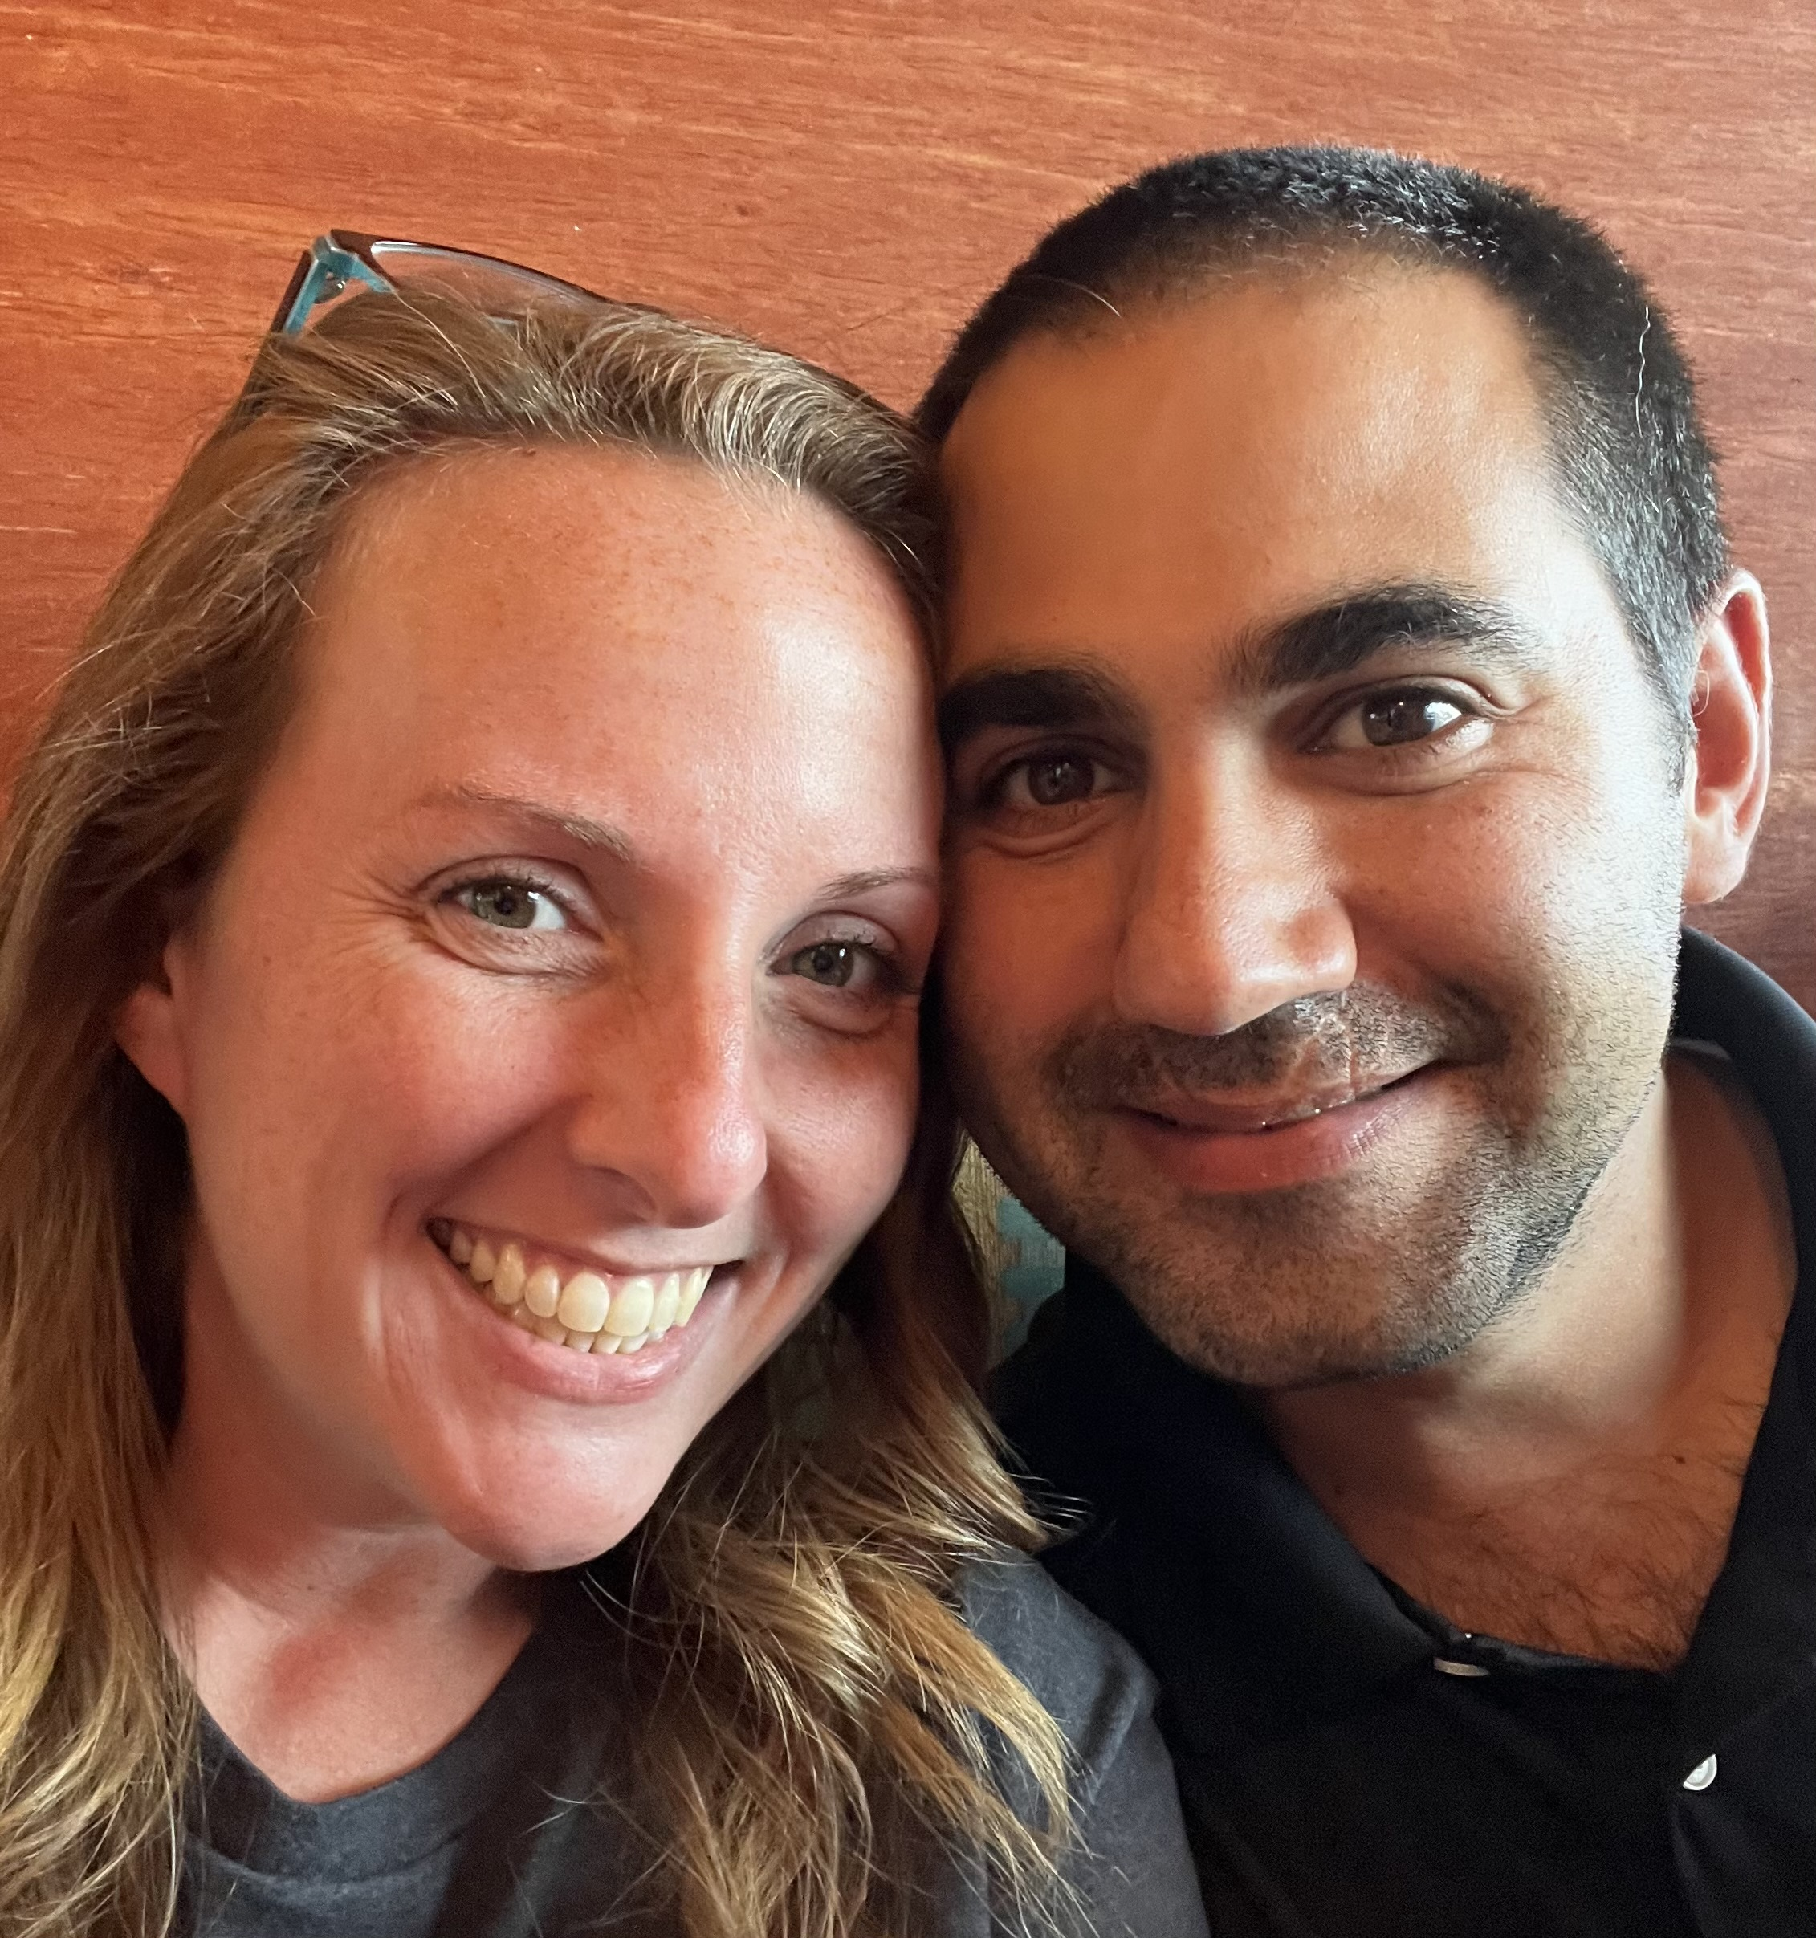
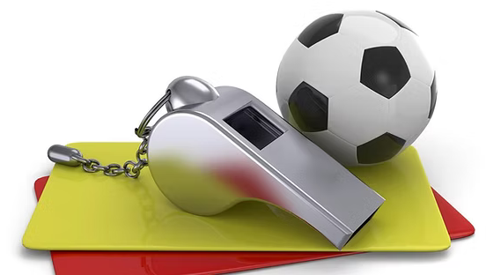
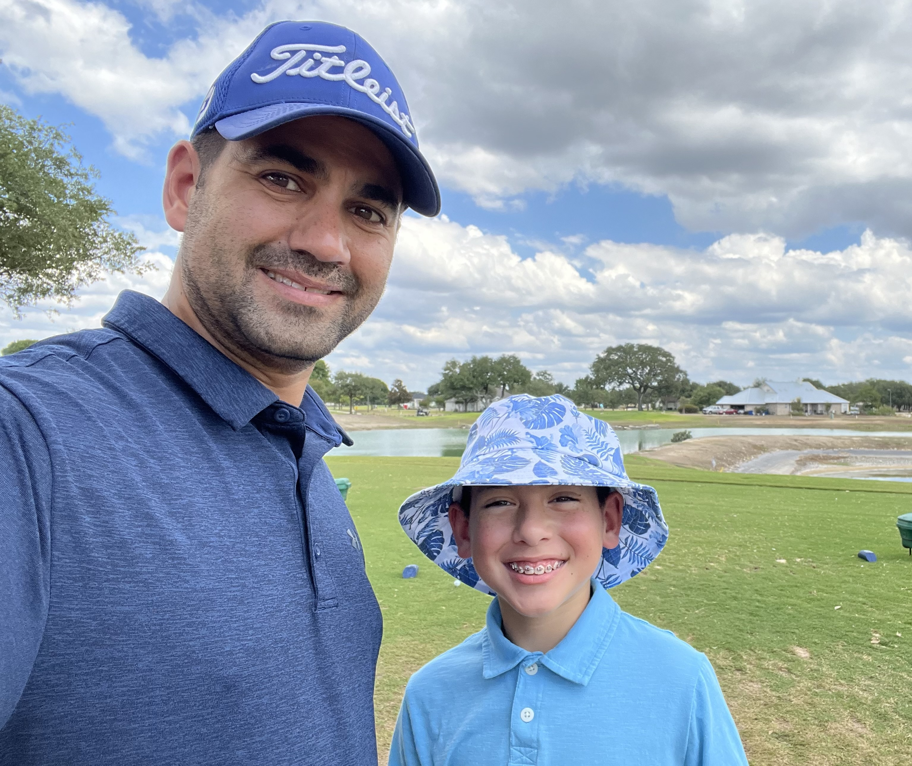
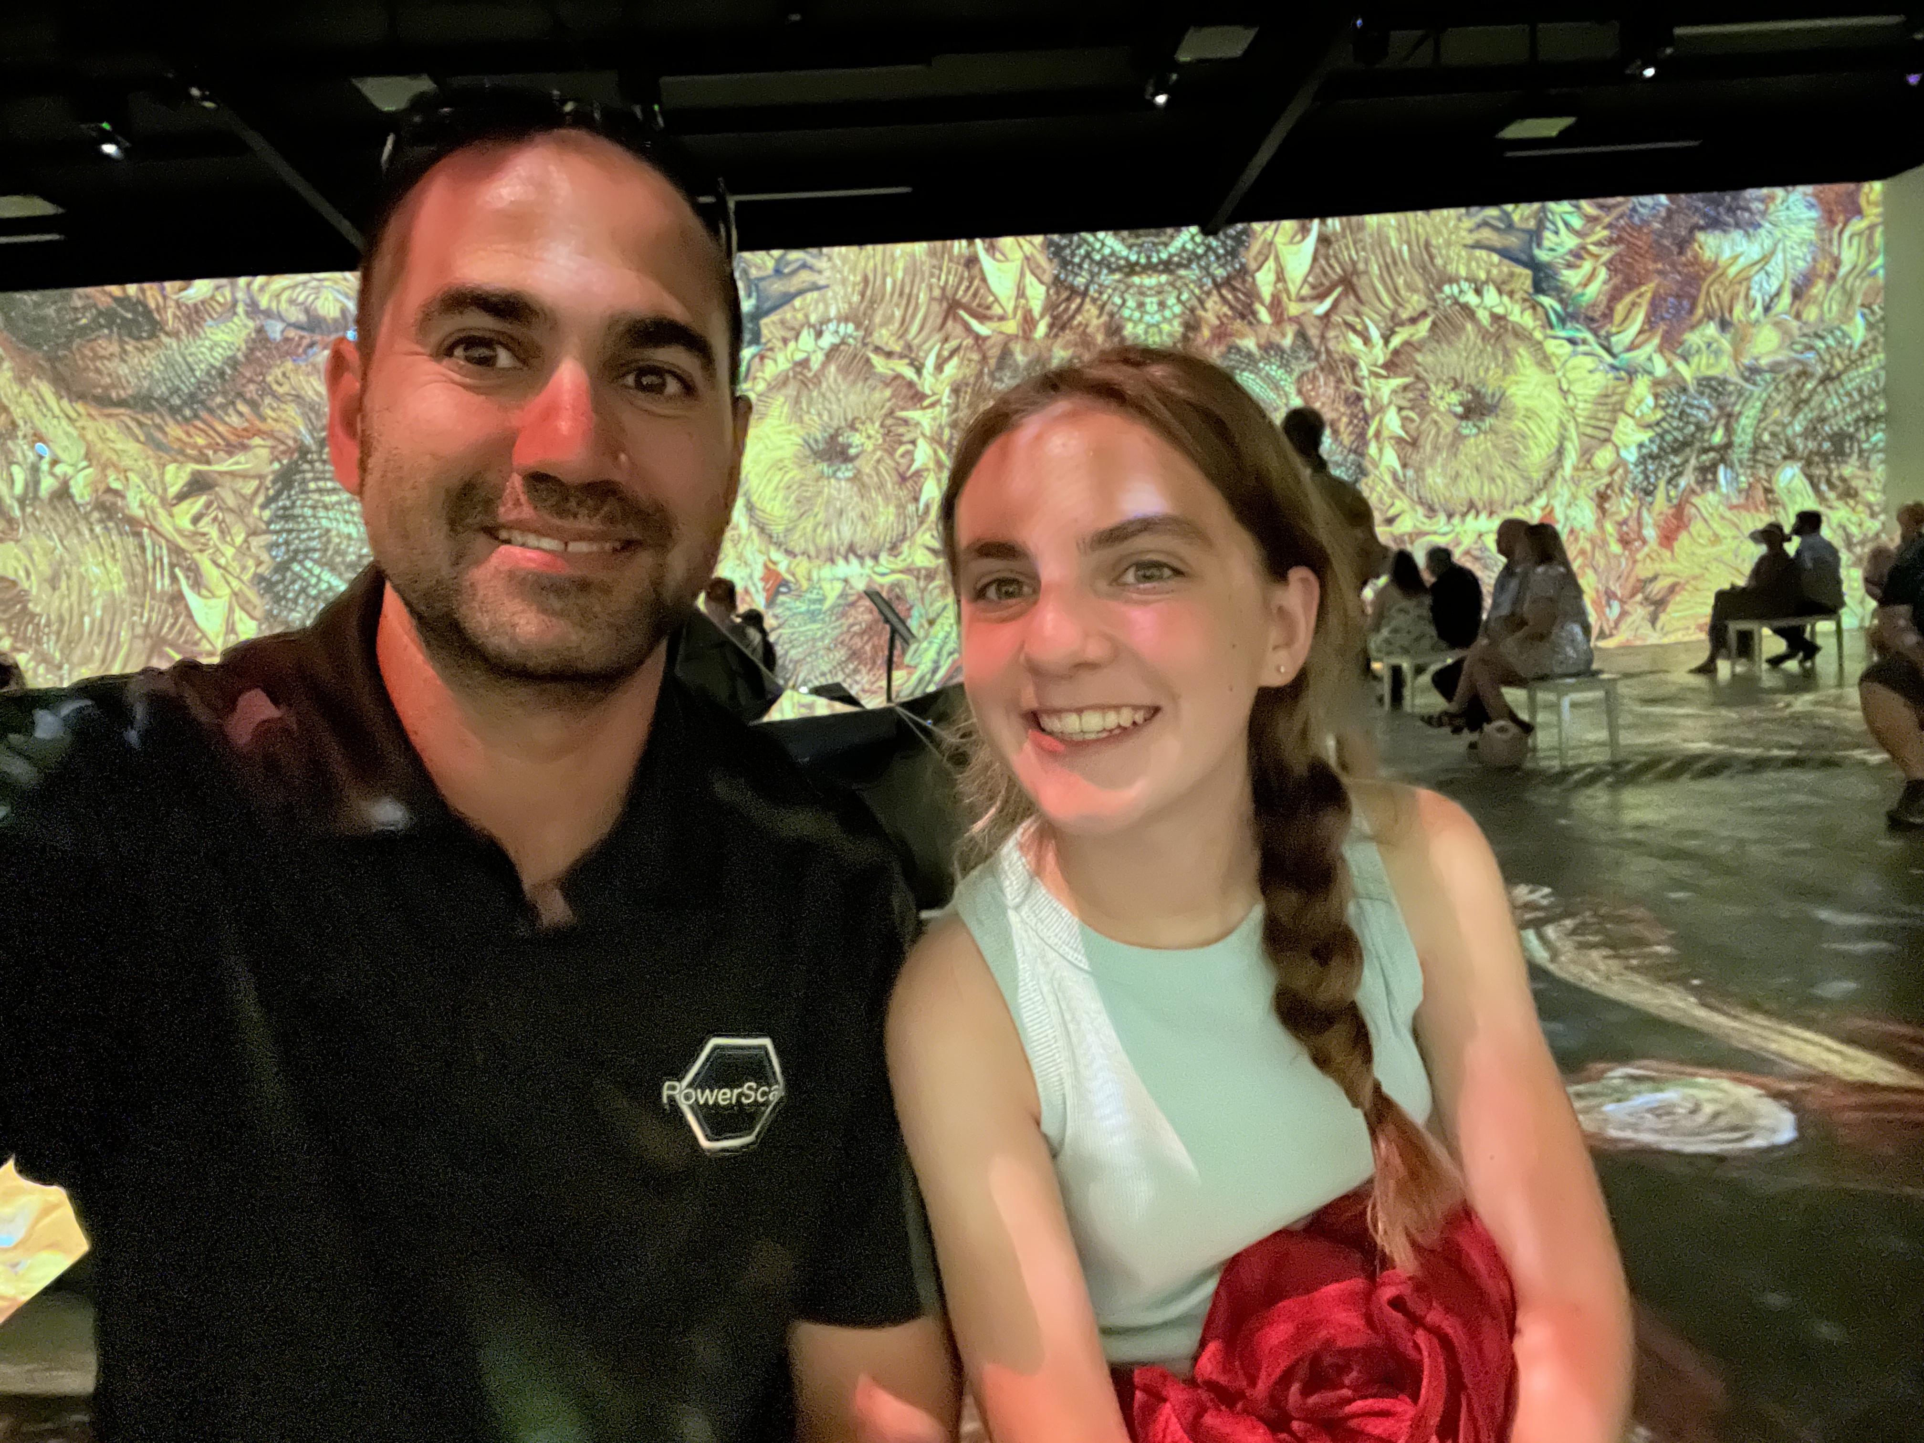

Justin P. Sider
Chief Information Officer – Belay Technologies
Blog
Invoke-automation.blog
Twitter(X)/Slack/GitHub
jpsider
VMware Programs
VMUG Advantage
VMUG Board of Directors
vExpert x10
VMware {Code} Coach
PowerShell Developer

Slide 6
Agenda
Introduction
Hyena
Shark
Snake
Squirrel
Bird of Prey
My Process
Final Thoughts

Slide 7
Introduction
Process vs. Tool
Process
Tools
Divide and Conquer
List
Brainstorm
Mind Map
Research
Root Cause Analysis
Trial and Error
Observe, Orient, Decide, Act (Loop)
Means-End Analysis
Step by step
Google
YouTube
Reddit
Atlassian Suite
Writing Code
Directions
Forums
Historical Documents
Rebooting

Slide 8
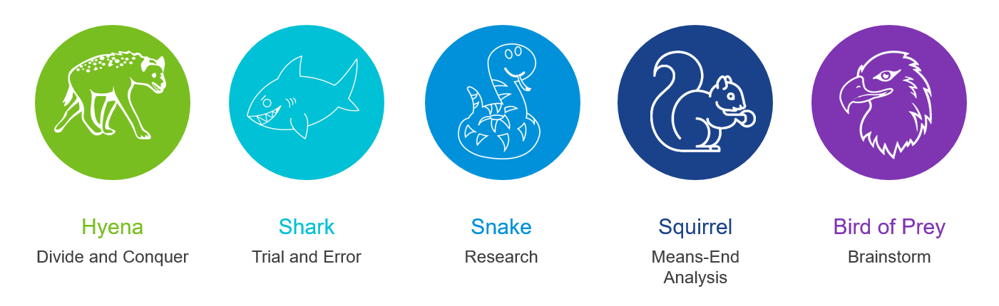
My Problem Solving Friends

Slide 9

About the Hyena
In the Wild
In the Office
1st site of a problem: | 50/50
Type of prey: | Alive/dead
Eating habits: | Chews, scavengers
Personality: | Antsy, on the move
Plays nice with others? | Yes
Problem solving method: | Divide and Conquer
Type of problems: | Easy to Medium
Office habits: | Hands in all the pots
Personality: | Latches on to others, clean up crew
Plays nice with others? | Cool kids club

Slide 10
Divide and Conquer
Great When:
It’s a complex problem.
You have some knowledge of the problem
You have a team to complete the work
The Bad:
Can be time consuming
Time is required upfront
Too many cooks in the kitchen
Promotes ‘Silos’
The Good:
Spreading the workload
Documentation happens organically
Things to Consider:
Organization is required to decompose the problem, solve the smaller problems, and compose the solution.

Slide 11
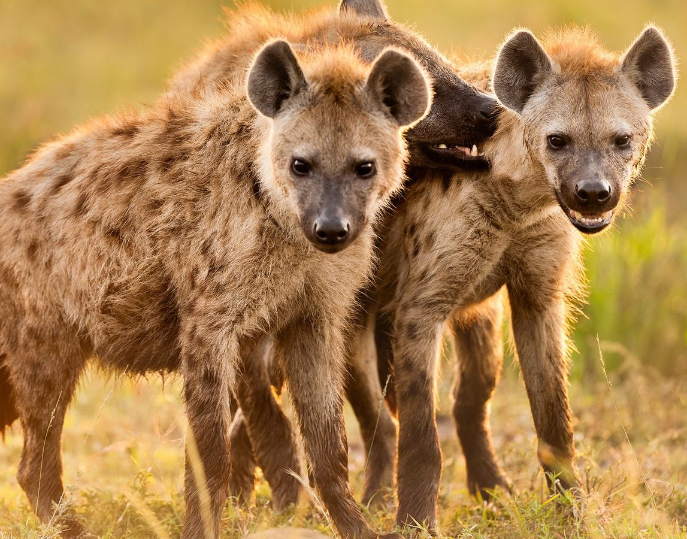
No Laughing Matter
Divide and Conquer
The Takeaway:
Great for a large team
Competition cannot exist within ranks
All for the greater good
Have a plan, before going in for the kill
Everyone’s goals/tasks must be clear
Requires a Strong minded & Organized leader

Slide 12

About the Shark
In the Wild
In the Office
1st site of a problem: | Attacks
Type of prey: | Alive
Eating habits: | Chews, chomps, rips
Personality: | Aggressive
Plays nice with others? | No
Problem solving method: | Trial and Error
Type of problems: | Mild to difficult
Office habits: | Door smasher
Personality: | No fear, selfish
Plays nice with others? | No

Slide 13
Trial and Error
Great When:
It’s a simple problem
You have little knowledge of the problem
Low risk of negative outcomes
The Bad:
Potentially going in blind
It could take a while
Not great for team environments
The Good:
You learn
You could get lucky
Things to Consider:
Document each Success and Failure
Record your screen (free tools available)

Slide 14
Shark Bait
Trial and Error
The Takeaway:
Potential for epic failures
Very repetitive
Lonely process
Documentation during the process is Required

Slide 15

About the Snake
In the Wild
In the Office
1st site of a problem: | Strikes
Type of prey: | Alive
Eating habits: | Swallows whole
Personality: | Lazy
Plays nice with others? | No
Problem solving method: | Research
Type of problems: | Hard
Office habits: | Appears to be busy
Personality: | Makes things more difficult
Plays nice with others? | No

Slide 16
Research
Great When:
It’s a complex problem
You have little knowledge of the problem
There is plenty of time
The Bad:
It will take a while
Not great for team environments
Potential for going down the wrong path
The Good:
You will learn
Even if it is outside of the original scope
Things to Consider:
Stay on schedule
Stay on task

Slide 17
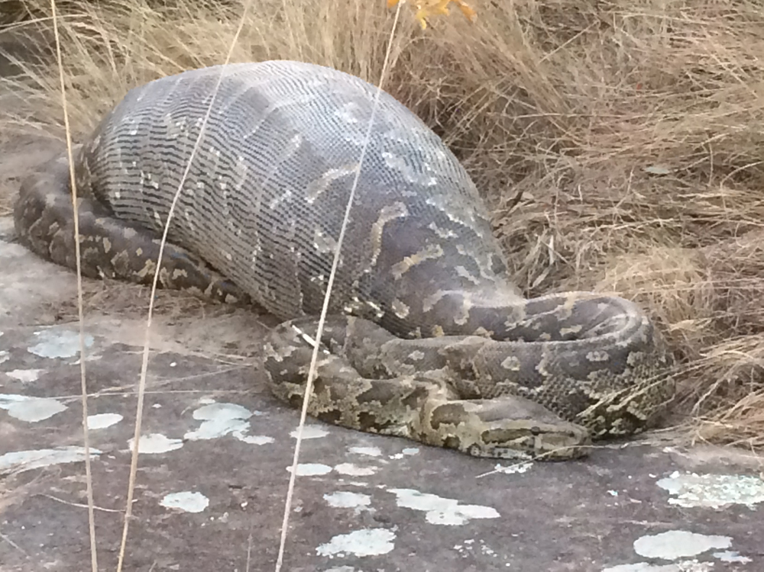
Scale-Ability
Research
The Takeaway:
It’s a slow process
Lonely
Leaves you vulnerable to Scope Creep
Digest the correct information
Work on these one at a time
Attempts to Solve the problem at one time

Slide 18

About the Squirrel
In the Wild
In the Office
1st site of a problem: | Runs
Type of prey: | Scavenger
Eating habits: | Chews, tiny pieces
Personality: | Always on the move
Plays nice with others? | Yes
Problem solving method: | Means-End Analysis
Type of problems: | Easy
Office habits: | Appears to be busy
Personality: | Has a solution for everything, somewhere
Plays nice with others? | Yes, very helpful

Slide 19
Means-End Analysis
Great When:
For any problem
You have a lot of knowledge about problem
There is plenty of time
The Bad:
Quite a bit of planning to ensure each action is correct
Sequence of actions need to be thought out
The Good:
A very recursive approach
Make decisions based on knowledge you have at the time of an action
Things to Consider:
Don’t lose sight of the goal, while making decisions along the way

Slide 20
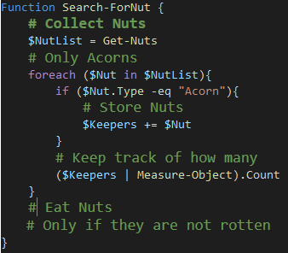
Cont.
Expand the outline into actions
Create the Initial Outline
Add Detail
Turn it into actions (code)
Go Nuts
Collect Nuts
Store Nuts
Eat Nuts
Go Nuts
Collect Nuts
Only Acorns
Store Nuts
Keep track of how many
Eat Nuts
Only if they are not rotten

Slide 21
Don’t go Nuts!
Means-End Analysis
The Takeaway:
Plan ahead
Give yourself plenty of time
Ask for help
Trust the process
Trust your decisions
Don’t be afraid to change directions
Don’t forget where you leave things

Slide 22

Bird of Prey
Brainstorm
In the Wild
In the Office
1st site of a problem: | Circles
Type of prey: | Alive
Eating habits: | Picks things apart
Personality: | Has an eye on everything
Plays nice with others? | Yes
Problem solving method: | Brainstorm
Type of problems: | Easy to hard
Office habits: | Always busy
Personality: | Focused to a flaw
Plays nice with others? | Yes, but avoids if possible

Slide 23
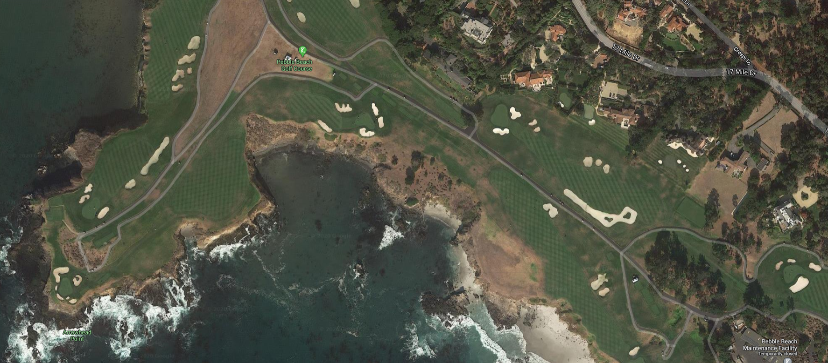
Birds Eye View

Slide 24
Birds Eye View
What I imagine they see
Road
Grass
Woods
Food
Humans
Water
Sand

Slide 25
Brianstorm
Put ideas down on paper
Road
Grass
Woods
Food
Humans
Water
Sand

Slide 26
Mind Maps
Roadkill
Cars
Flush the ideas out
Rabbit
Snake
Road
Avoid
Grass
Squirrel
Rabbit
Woods
Mole
Food
Squirrel
Avoid
Humans
Snake
Crab
Water
Sand
Danger
Fish
Turtle
Turtle

Slide 27
Brainstorm
Great When:
For any problem
You have a lot or a little knowledge about problem
There is plenty or no time
The Bad:
Requires you to put ideas down on paper
Mapped out ideas still need an order of action
The Good:
Allows for creativity and depth
You can share the visualization with others
Things to Consider:
Mind Maps can be as detailed or basic as the problem requires
There is not always a clear direction

Slide 28
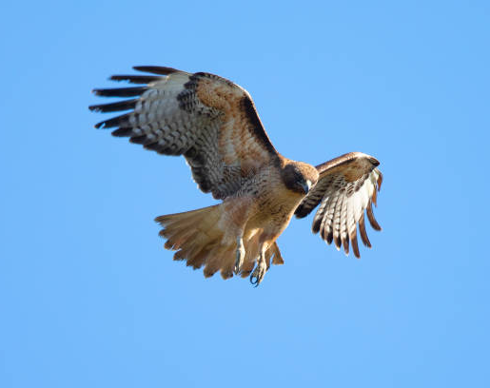
Go Above and Beyond
Brainstorm
The Takeaway:
Detailed approach
Flexible structure
Allows for parts of the map to be assigned to others
Documentation is created along the way

Slide 29

My Process
A Hybrid approach to Problem-Solving
Introducing, The Flying Squirrel (Sugar Glider). Hybrids are okay in our world right?

Slide 30
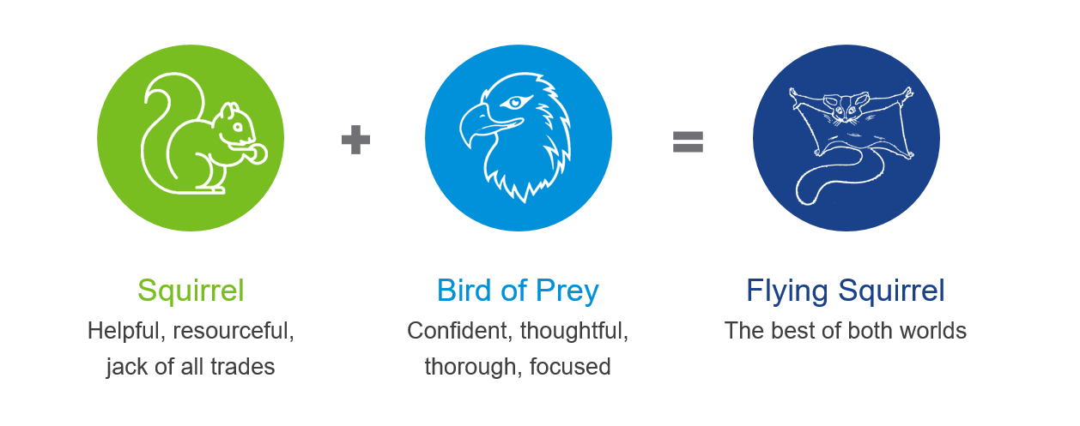
Hybrid Problem Solving
Adapt to your surroundings

Slide 31

The Flying Squirrel
In the Wild
In the Office
1st site of a problem: | Glides
Type of prey: | Scavenger
Eating habits: | Chews, tiny pieces
Personality: | Always on the move
Plays nice with others? | Yes
Problem solving method: | Means-End Brainstorm
Type of problems: | Easy to hard
Office habits: | Subject Matter Expert
Personality: | Driven, focused
Plays nice with others? | Yes, very helpful

Slide 32
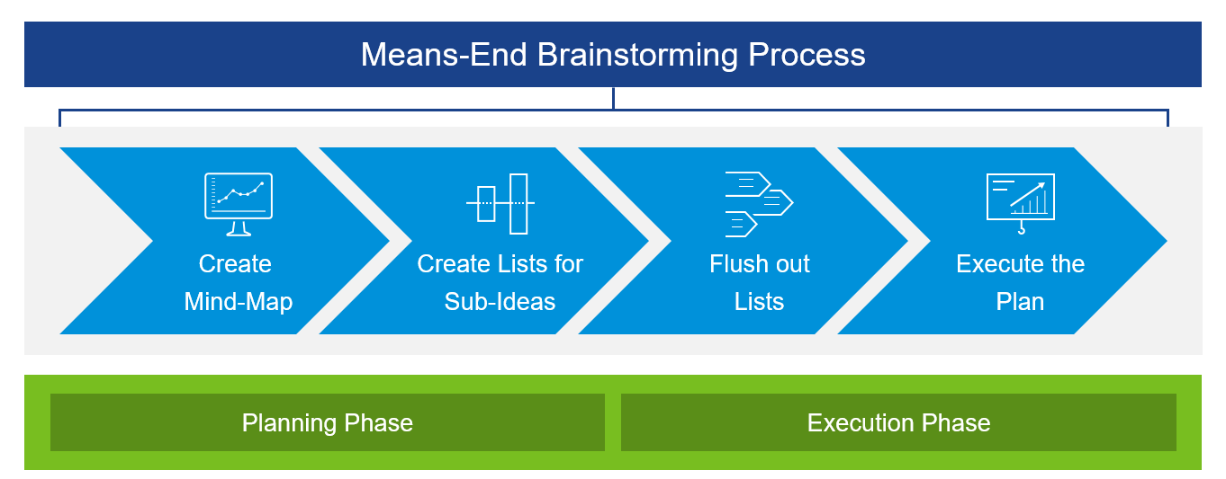
Means-End Brainstorming
A Practical Hybrid Approach

Slide 33
It’s okay to be a little nuts!
The Takeaway:
Combines the best of the Squirrel & Bird of Prey
Brainstorm
Means-End Analysis
Can be done solo or with a team
Flexible approach to Problem-Solving

Slide 34
Final Thoughts
How you get there matters
How you document, ensures you don’t get there again
Create an internal Knowledge Base (KB’s)
Draw a picture
Identify what you know
Identify what you don’t know
Identify what you need to know

Slide 35
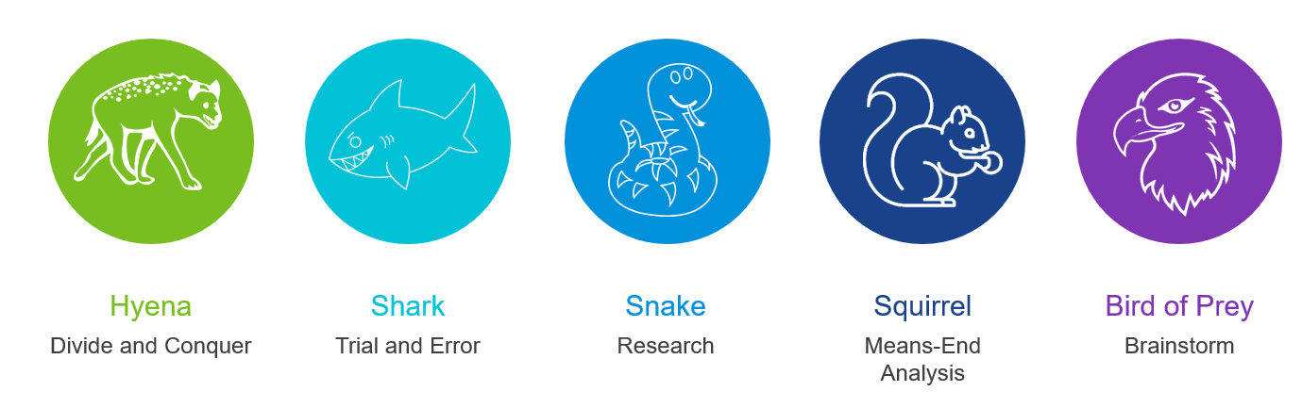
Which one are you?
Let me know on Twitter! @jpsider - #MyITAnimal #VMwareExplore2025 #MyVMUG

Slide 36
Please take your survey.
Broadcom Proprietary and Confidential. Copyright © 2025 Broadcom.
All Rights Reserved. The term “Broadcom” refers to Broadcom Inc. and/or its subsidiaries.

Slide 37
Thank You
Text
Broadcom Proprietary and Confidential. Copyright © 2025 Broadcom.
All Rights Reserved. The term “Broadcom” refers to Broadcom Inc. and/or its subsidiaries.

